Slide 1
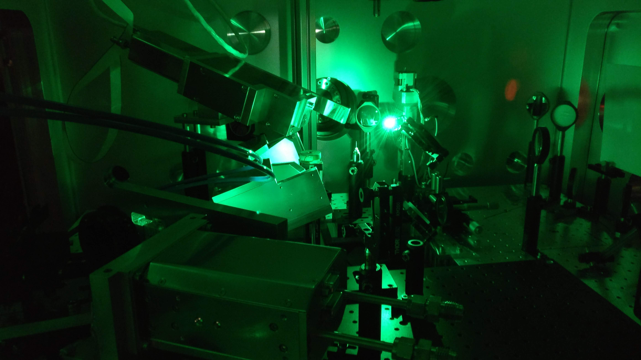
Soft X-Ray Spectrometers for Laser Driven Backlighter Experiments
Proposal Presentation by Carlos Butler
Notes:
Here we see the experimental chamber for the experiment in may of this year, with spectrometers visible.

Slide 2
Motivation
Spectrometer Design
Mechanical Design
Outlook

Slide 3
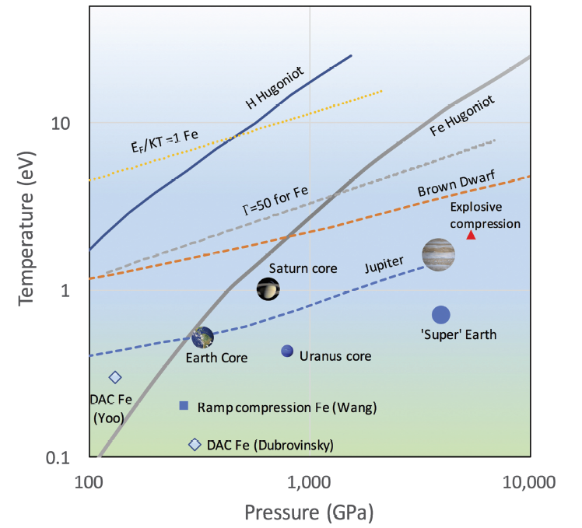
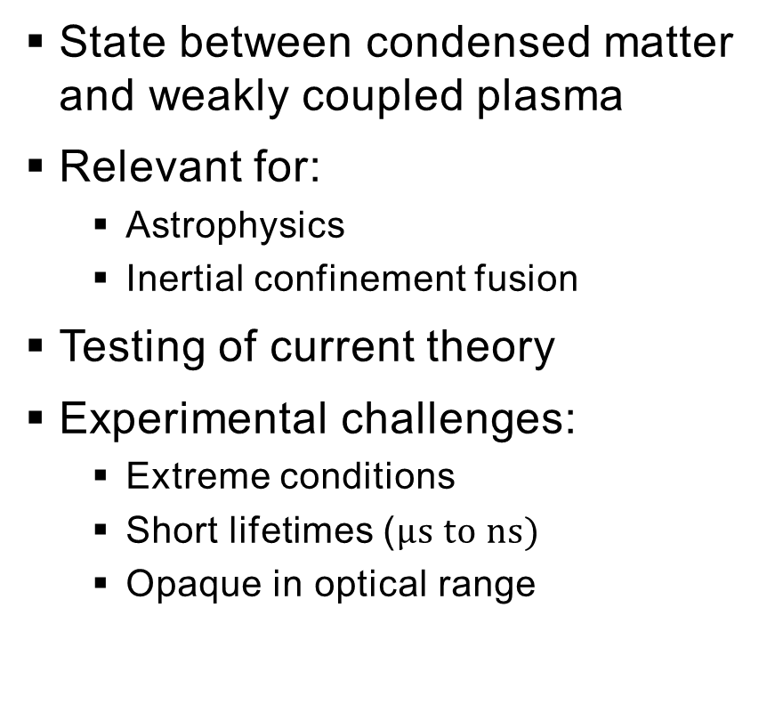
Warm Dense Matter (WDM)
State between condensed matter and weakly coupled plasma
Relevant for:
Astrophysics
Inertial confinement fusion
Testing of current theory
Experimental challenges:
Extreme conditions
Short lifetimes ($μs to ns)$
Opaque in optical range
Riley D., Plasma Phys. Control. Fusion 60, 2018
Notes:
Temperatures from 1 – 100 eV, pressures > 100 GPa and above solid density
Say whole graph is for WDM
Breaks common approximations in theory, since strong coupling and electron degeneracy
Due to experimental challenges, specialized diagnostic techniques required.

Slide 4
Warm Dense Matter (WDM)
State between condensed matter and weakly coupled plasma
Relevant for:
Astrophysics
Inertial confinement fusion
Testing of current theory
Experimental challenges:
Extreme conditions
Short lifetimes ($μs to ns)$
Opaque in optical range
Setup
Backlighter
target
Plasma
Intense Laser
WDM
Sample
X-rays
Ion Beam
Notes:
As opaque in optical range, use x-rays
Unique chance to combine heavy ion beam and PW laser at GSI and FAIR
One of the methods using x-rays for diagnostics is the following, which will be used in our experiments

Slide 5
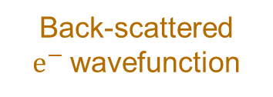
X-Ray Absorption Fine-Structure (XAFS)
Source
Sample
Spectrometer
X-rays
Transmitted x-rays
Studies structures around edge (rapid rise) in absorption spectrum
Structures caused by quantum scattering
Photoelectron wavefunction
Atoms in lattice
For WDM, can extract:
Density
Temperature
Ionic order
Ionization
X-ray
Back-scattered $e^{−}$wavefunction
Notes:
A mature method used in numerous fields (biology, solid-state physics, since 1988 WDM research
Edge is jump in absorption at ionization energy of a shell
Process in diagram happens in sample (point out)
XAFS: 1) x-ray photoionizes electron from absorbing atom
2) photoelectron quantum mechanically scatters on neighboring electron
3) part of wavefunction reflected back to absorbing atom
4) Backscattered wavefunction modulates electronic state at first atom
5) absorption coefficient dependent on electronic state → modulates mu as well → structures dependent on lattice and structure
IMPORTANT: all happens in a single coherent quantum state at absorbing atom → all absorption events effected!
Next will see example of an absorption spectrum

Slide 6
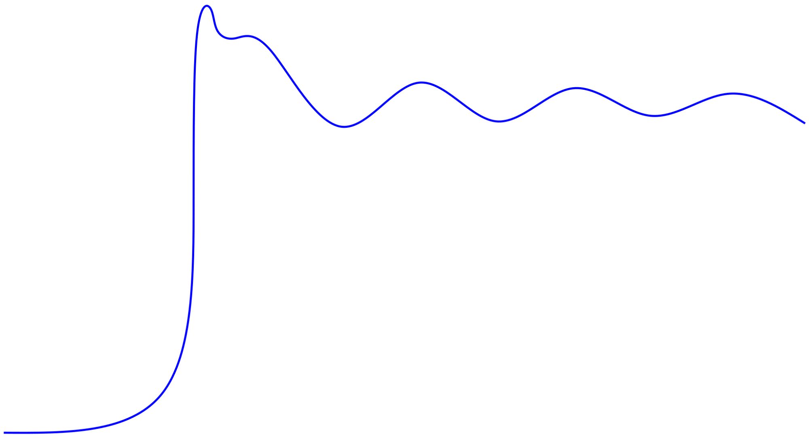
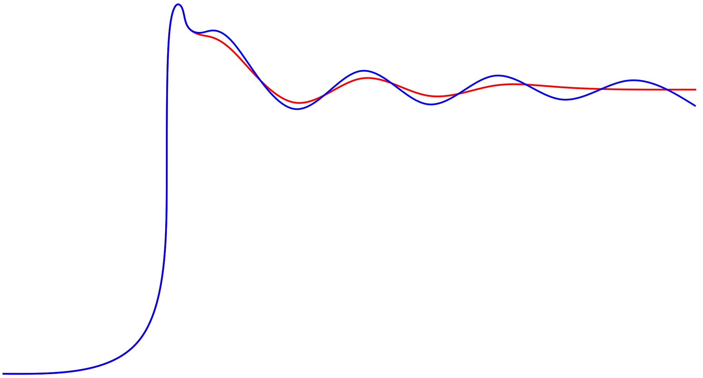
XAFS Example
Extended X-ray Absorption Fine-Structure (EXAFS)
X-ray Absorption Near Edge Structure (XANES)
High T Low T
Absorption Coefficient
For example:
Amplitude of oscillations → temperature
Edge
Photon Energy

Slide 7
Planned Experiments
End goal: XAFS experiments on WDM of aluminum
Proposal goal: Design two spectrometers for testing in laser-only experiment
Spectrometer
(reference)
X-rays
Backlighter
target
PW Laser (FAIR)
PHELIX (GSI)
Aluminum
Sample
Spectrometer
(absorption)
SIS-8 (GSI)
SIS-100 (FAIR)
Notes:
Final experiment will be at FAIR probing WDM with SIS-100
For that need pre-experiments

Slide 8
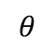
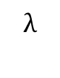
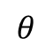
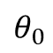
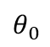
Fundamentals of X-Ray Spectrometers
Goal: Spectrally disperse photons on detector
X-ray spectrometers:
Crystal as dispersive element (Bragg condition)
Properties dependent on crystal form and geometry
In proposal: One flat crystal and one spherically bent crystal geometry → test two spectrometers
$$λ$$
X-ray Source
Detector
$$θ$$
$$θ$$
$$θ_{0}$$
$$θ_{0}$$
Crystal
Notes:
Goal is to disperse wavelengths
Can realize scheme in many different ways. Largely dependent on crystal bending

Slide 9

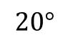

Dual Unbent Crystal speCtrometer (DUCC)
Top view:
Crystal
Side view:
Backlighter
Target
Backlighter
Target
Laser Beam
Detector
$$20°$$
Laser Beam
Sample
Crystal
Sample
Detector
$$E_{s}$$
$$E_{t}$$
Ion beam
(Future Experiment)
Crystal
View on Detector
Notes:
Two geometries used

Slide 10
Focusing Spectrograph with Spatial Resolution in 1-D (FSSR-1D)
Spherical crystal
Two planes:
Dispersive plane (with Rowland Circle)
Vertical plane (perpendicular to dispersive)
Spectral focusing in dispersive plane
1-D imaging in vertical plane
Advantage: Better resolution as source size negligible
Rowland Circle
Vertical
Detector
Source
Dispersive
Vertical
Dispersive
On detector
Source

Slide 11
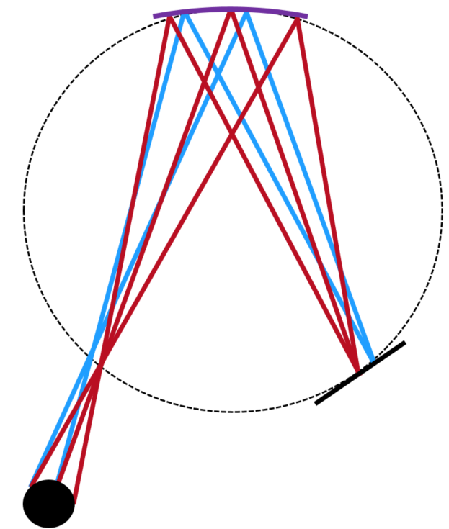
Comparison
DUCC
FSSR
Flat crystal → basic geometry
ADP crystal → excellent intrinsic resolution (due to crystal)
Spherically bent crystal → high intensity and resolution (due to geometry)
Mica crystal → common in literature
Dual channel → only one detector
Small E-range → cover XANES (near edge) at high resolution
1-D imaging → low background
Larger E-range → cover XANES and EXAFS at lower resolution

Slide 12
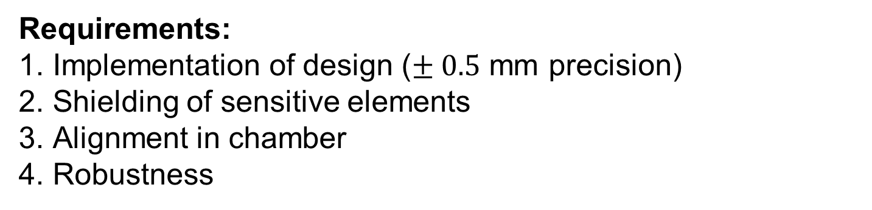
Components and Requirements
Requirements:
Implementation of design ($± 0.5$ mm precision)
Shielding of sensitive elements
Alignment in chamber
Robustness
Main Components | Purpose
Greateyes x-ray camera | Record spectra
Aluminum housing | Structure and shielding
Carbon filters | Insulation of camera chip
Mylar (plastic) filters | Shielding of crystals
Alignment apparatus | Alignment

Slide 13
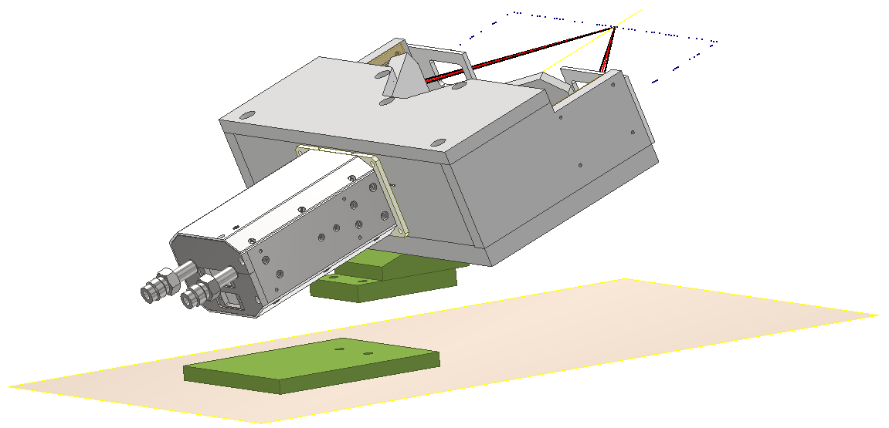
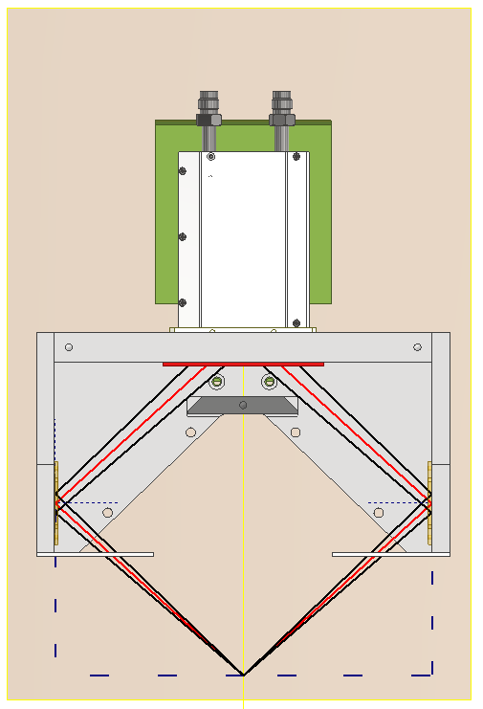
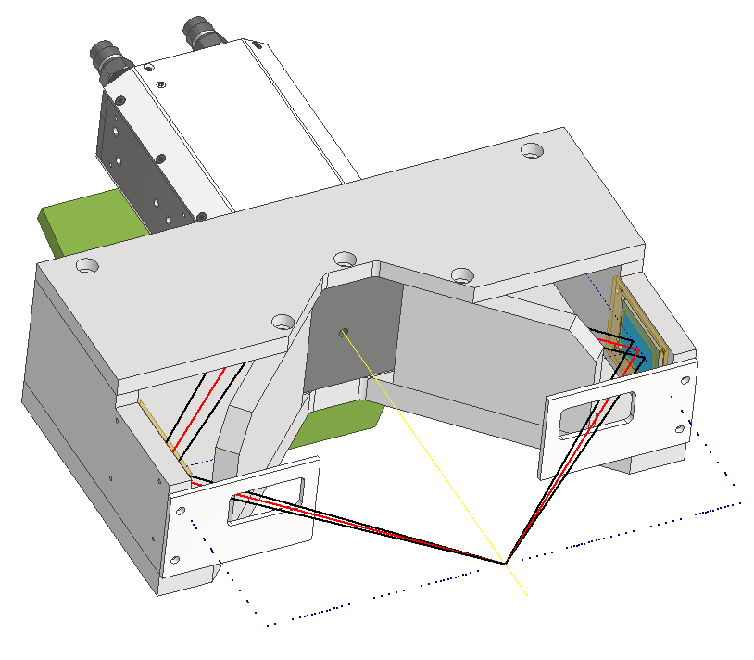
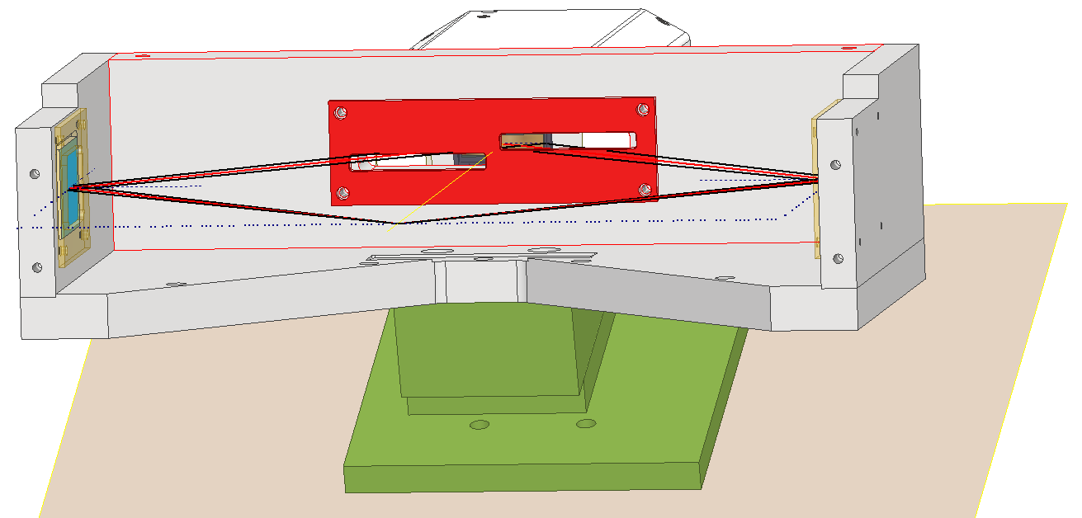
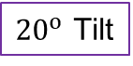
DUCC
Back
Scheme
Camera
${20}^{o}$ Tilt
Top
Front/Side
Front
Pointer Holder
Carbon Filter Holder
Blast Shields

Slide 14
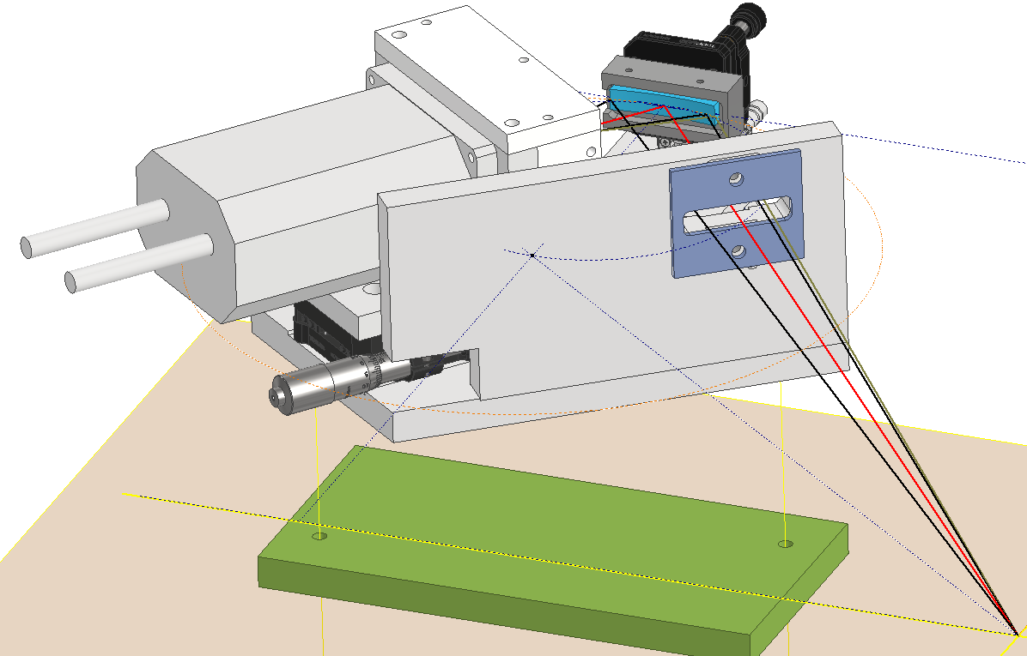
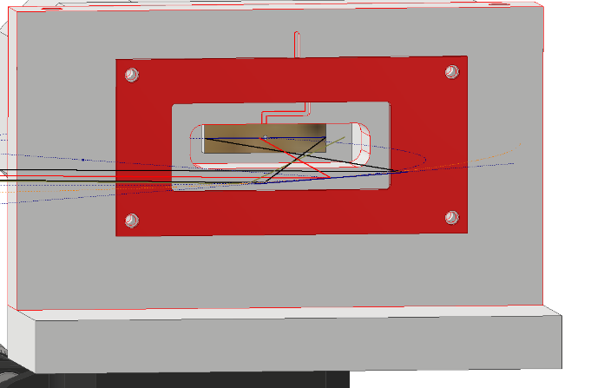
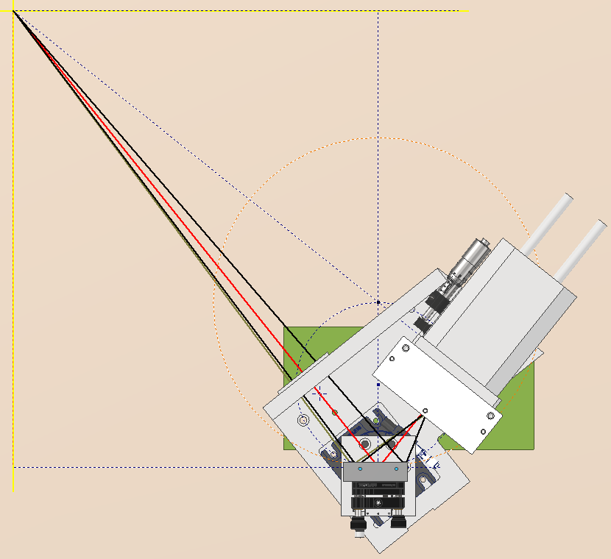
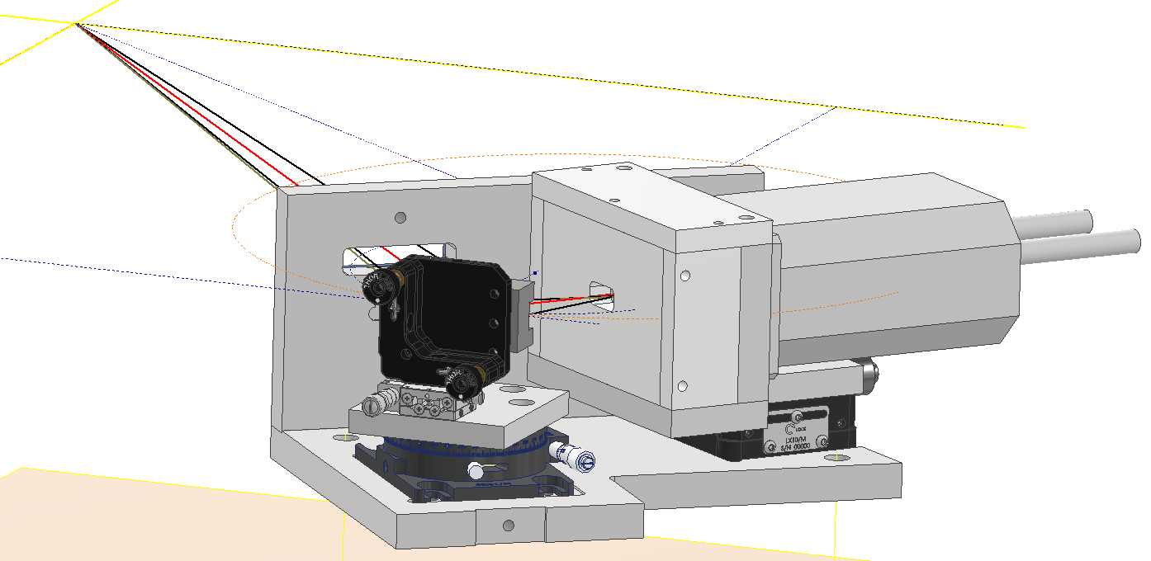
FSSR
Scheme
Front
Crystal
Blast Shield
Inside Snout
Main Shielding
Top
Back
Carbon Filter Holder
Snout
Stages for Alignment

Slide 15

Summary
Goal: Design soft x-ray spectrometers for XAFS of Al samples using laser driven backlighters
Design: Two spectrometers
DUCC: Flat crystal geometry with two channels, FSSR: Spherical crystal geometry with 1-D imaging

Slide 16
Outlook
Both spectrometers tested in May beamtime (laser-only experiment)
Next steps:
Develop generalized code for spectra processing
Assess performance using spectra
Use results to inform spectrometer design for combined (laser and ion beam) experiment in 2024
Thanks for your attention!

Slide 17
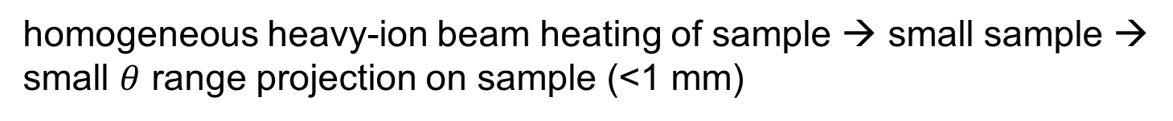
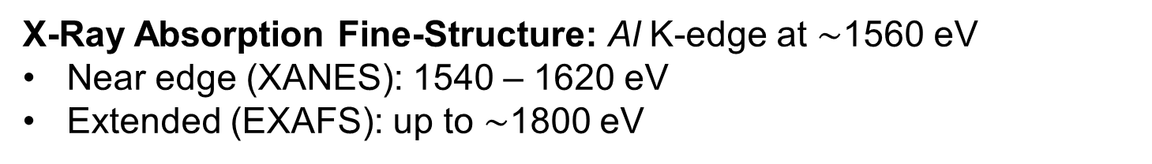
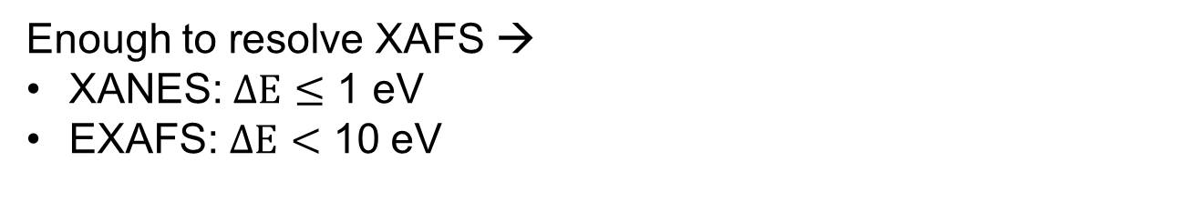
Considerations
X-Ray Absorption Fine-Structure: Al K-edge at $∼$1560 eV
Near edge (XANES): 1540 – 1620 eV
Extended (EXAFS): up to $∼$1800 eV
Energy Range
Sample Size
Resolution
Intensity
Physical Size
homogeneous heavy-ion beam heating of sample → small sample → small $θ$ range projection on sample (<1 mm)
Enough to resolve XAFS →
XANES: $ΔE≤$ 1 eV
EXAFS: $ΔE<$ 10 eV
High as possible without saturation
Fit in HHT chamber → length < 550 mm

Slide 18
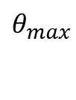
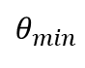
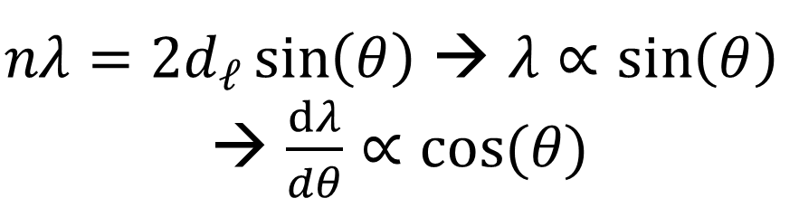

Sample Size Consideration
Source
$$1 mm$$
$nλ=2d_{ℓ}\sin\left(θ\right)$ → $λ∝\sin\left(θ\right)$
→ $\frac{dλ}{dθ}∝cos⁡(θ)$
Sample
Ion beam
(Future Experiment)
$$θ_{max}$$
$$θ_{min}$$
Crystal

Slide 19
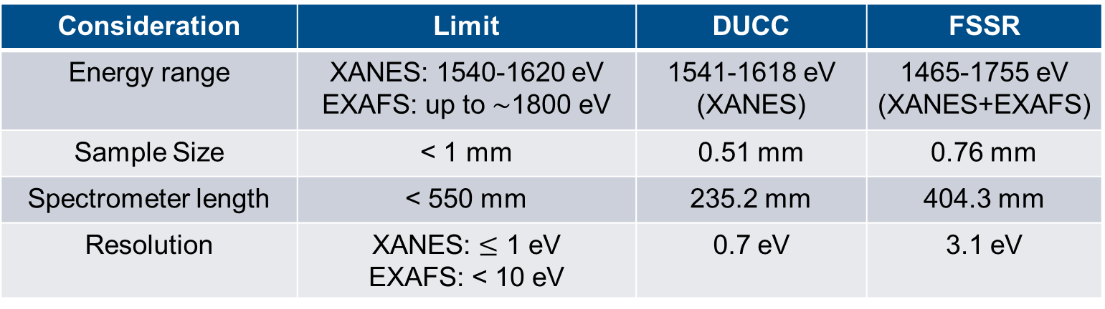
Consideration | Limit | DUCC | FSSR
Energy range | XANES: 1540-1620 eV EXAFS: up to $∼$1800 eV | 1541-1618 eV (XANES) | 1465-1755 eV (XANES+EXAFS)
Sample Size | < 1 mm | 0.51 mm | 0.76 mm
Spectrometer length | < 550 mm | 235.2 mm | 404.3 mm
Resolution | XANES: $≤$ 1 eV EXAFS: < 10 eV | 0.7 eV | 3.1 eV

Slide 20
Specifications
DUCC
FSSR
Spec | DUCC | FSSR
Energy Range | 1541-1618 eV (XANES) | 1465-1755 eV (XANES+EXAFS)
Intensity on Detector | Lower | High
Resolution | 0.7 eV | 3.1 eV
Physical Length | 235.2 mm | 404.3 mm

Slide 21
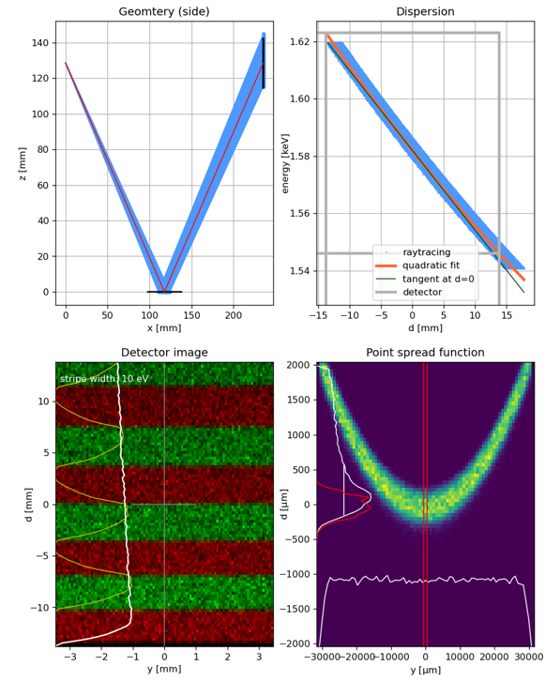
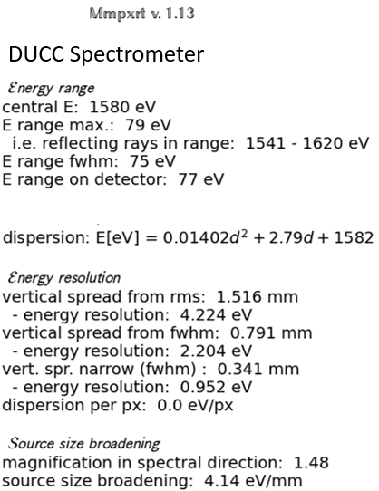
Simulation of DUCC

Slide 22
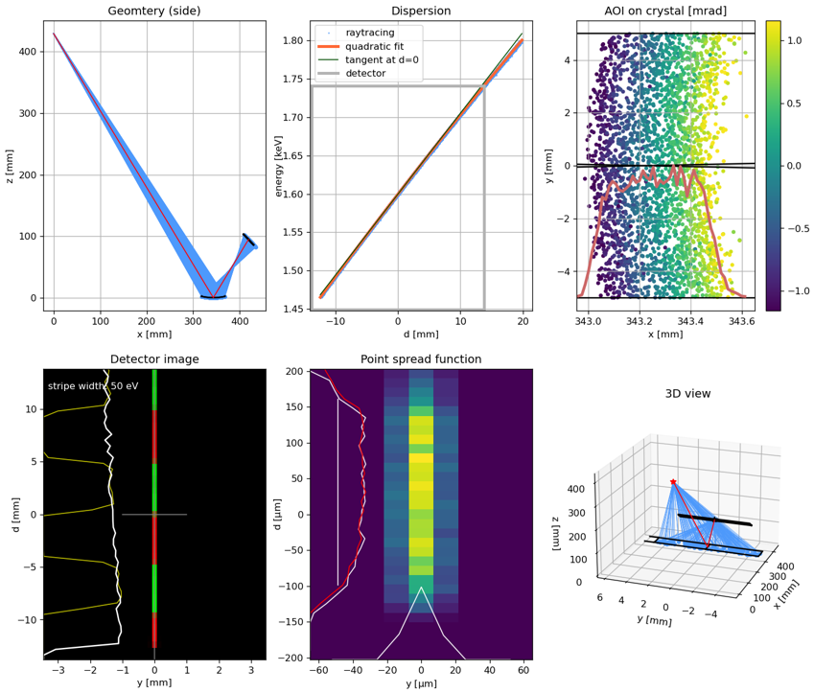
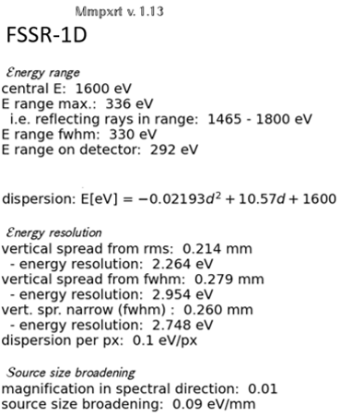
Simulation of FSSR

Slide 23
Planned Experiments
WDM
experiment
in APPA Cave
at FAIR (>2025)
HHT Cave with PHELIX and SIS-18 at GSI (2024)
HHT Cave with only PHELIX at GSI (2023)
End goal: XAFS experiments on WDM of aluminum
Proposal goal: Design spectrometers for absorption spectroscopy
Preparatory experiments

Slide 24
Summary
Goal: Design soft x-ray spectrometers for XAFS of Al samples using laser driven backlighters
Design: Two spectrometers
DUCC: Flat crystal geometry with two channels, FSSR: Spherical crystal geometry with 1-D imaging
Spec | DUCC | FSSR
Energy Range | 1541-1618 eV (XANES) | 1465-1755 eV (XANES+EXAFS)
Intensity on Detector | Lower | High
Resolution | 0.7 eV | 3.1 eV

